Slide 1
B for Best Presents:
United Kingdom General Elections
AleX ORR
Cameron ABRAHAM
Michael GOLDSMITH
Jamie CHAVEZ-MALACRA
MUNAWAR ABDUL GAFFUR

Slide 2
Some Background on Voting Systems
Ranked Voting (eg Alternative Vote/IRV, Condorcet, Borda)
Party List Proportional Representation
Semi Proportional Representation
Approval Voting
Score Voting
First past the post

Slide 3
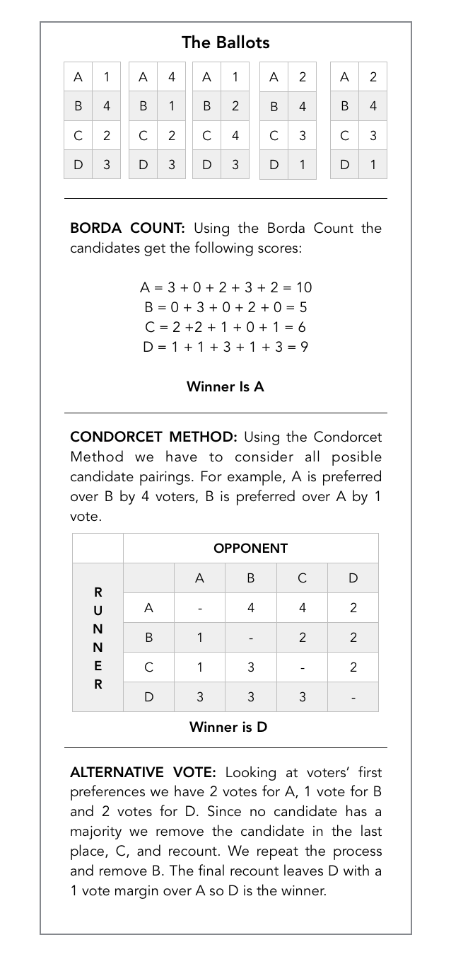
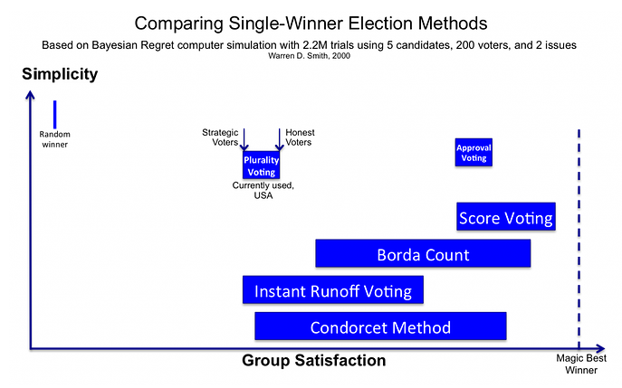

Slide 4
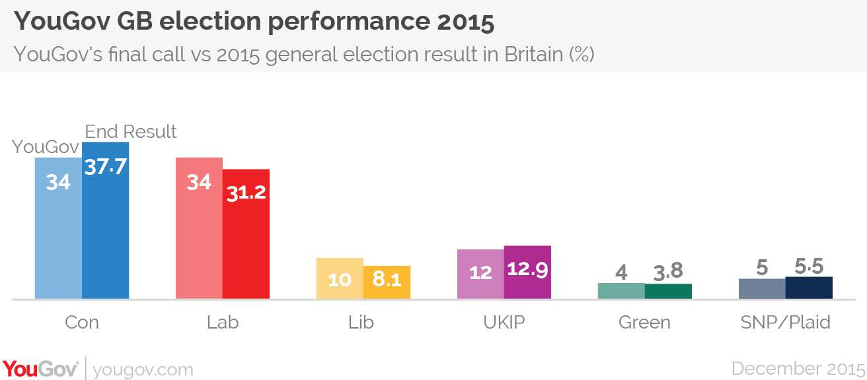
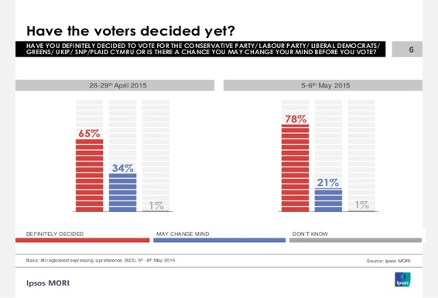
Opinion Polling

Slide 5
Major Findings from our Reports
There are several different electoral systems in use around the world, all of which have varying features
Proportional electoral systems were created to fix some of the problems of FPTP
However FPTP does have a few advantages which creates some balance
Opinion polling was not accurate at the last election failed to predict the outcome, but they were only ever meant to be a snapshot
Electoral systems have been designed for over 200 years and we will continue to debate how best to count votes in elections
To read more visit the report section of our wiki: http://abstractrivialities.com/MAT1041/report/

Slide 6
Regional Analysis
2010
Region Average | CON | LAB | LIB | UKIP | GRN | NAT | Minor | Other
Outer Scotland | 7604 | 14360 | 9947 | 379 | 342 | 9044 | 44 | 342
Central Scotland | 6281 | 21334 | 5451 | 189 | 218 | 7481 | 55 | 467
Northern Ireland | 5687 | 6165 | 9345 | 0 | 197 | 9552 | 5310 | 1181
National Average | 16660 | 13412 | 10776 | 1415 | 438 | 1275 | 490 | 1208
Nationalist surge in Scotland, largely won at the expense of Labour and the Liberal Democrats.
In contrast to Northern Ireland, unionists outperformed their 2010 showing, resulting in a seat gain in Fermanagh and South Tyrone.
2015
Region | CON | LAB | LIB | UKIP | GRN | NAT | Minor | Other
Outer Scotland | 8293 | 10090 | 5104 | 860 | 883 | 23972 | 33 | 107
Central Scotland | 6249 | 14232 | 2087 | 724 | 405 | 25456 | 8 | 153
Northern Ireland | 6385 | 5545 | 10237 | 1018 | 379 | 9791 | 4786 | 1754
National Average | 17601 | 14534 | 4000 | 5971 | 1781 | 2793 | 245 | 307

Slide 7
Most winnable seats for UKIP
2015
nth place | CON | LAB | LIB | UKIP | GRN | NAT | Minor | Other
1 | 333 | 235 | 16 | 1 | 1 | 63 | 1 | 0
2 | 187 | 253 | 67 | 120 | 4 | 14 | 5 | 0
3 | 111 | 106 | 38 | 365 | 19 | 5 | 4 | 2
4 | 14 | 47 | 342 | 78 | 133 | 22 | 13 | 6
Mostly on the east coast of Britain.
Thurrock is the most winnable seat but UKIP are 3rd.
Most of these seats have historically been Labour.
UKIP Target Seats | Difference in votes from the winning party
Thanet South | 2,812
Hartlepool | 3,024
Boston and Skegness | 4,336
Dagenham and Rainham | 4,980
Stoke-on-Trent Central | 5,179
Heywood and Middleton | 5,299
Rochester and Strood | 7,133
Rother Valley | 7,297
Basildon South and East Thurrock | 7,691
West Bromwich West | 7,742

Slide 8
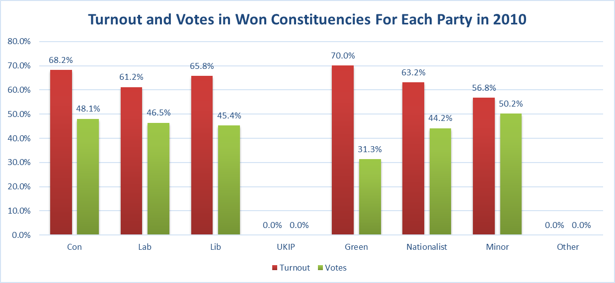
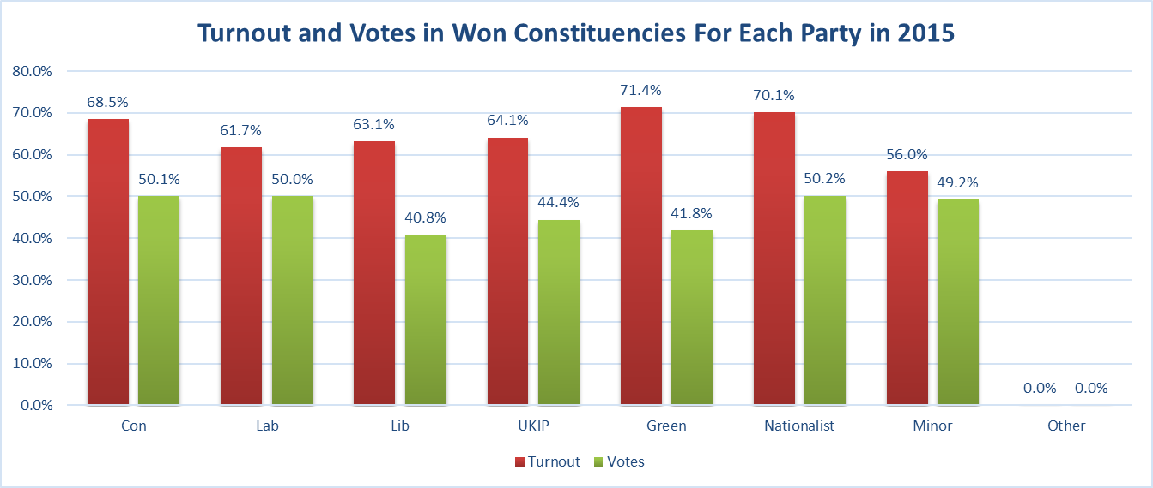
Turnout
Labour clearly win constituencies on low turnouts. Conservatives have a tougher fight.

Slide 9
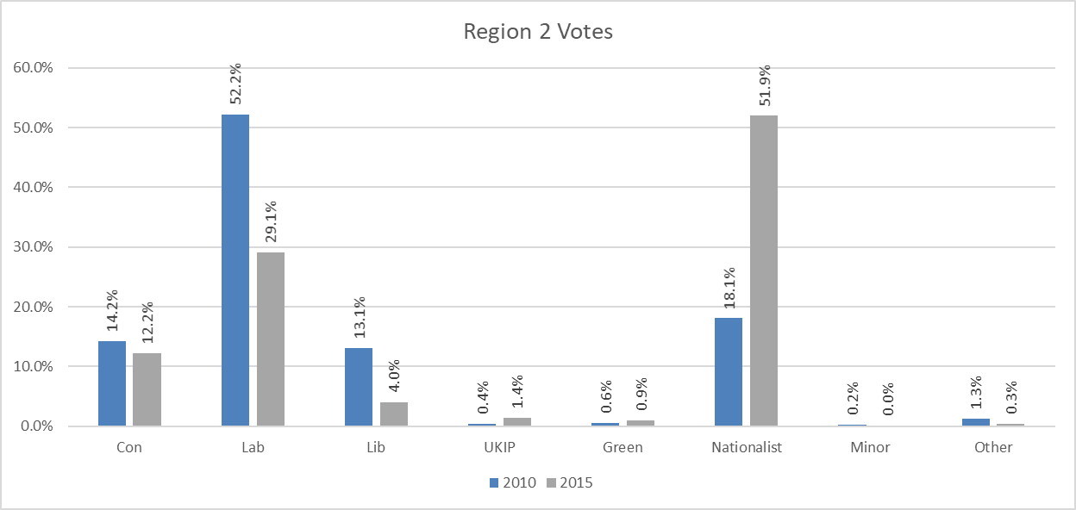
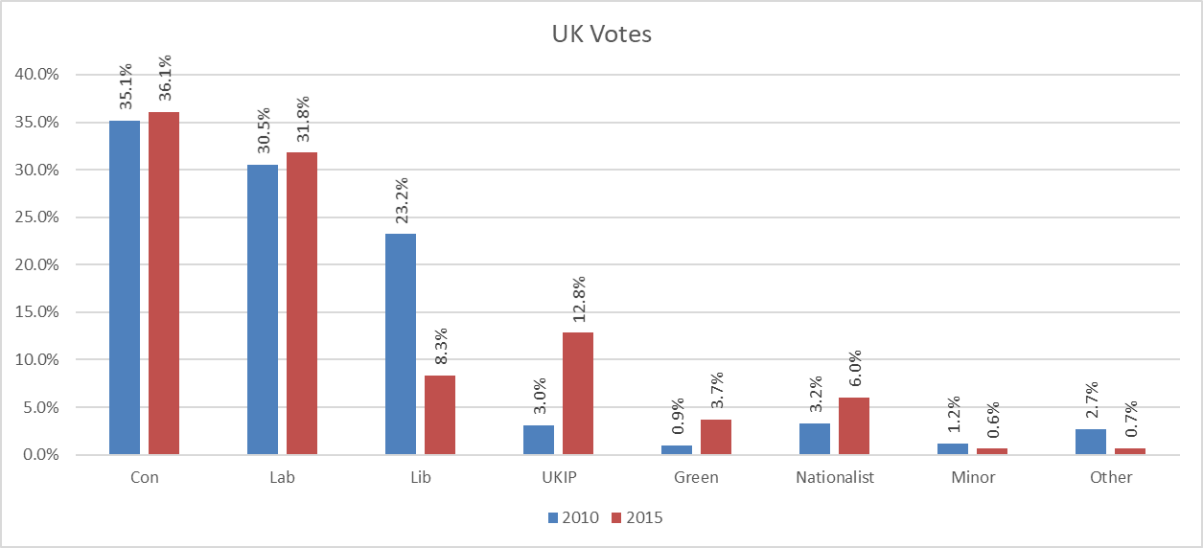
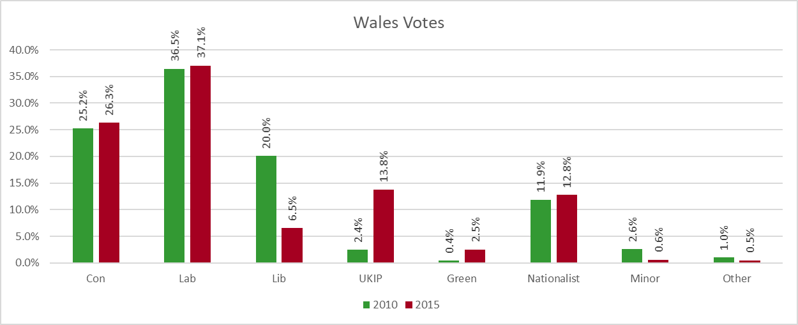
Swings
Swing to the Conservatives from Labour in both Wales and the UK as a whole.
However the bigger story is the collapse in the Liberals and the surge in the UKIP vote.

Slide 10
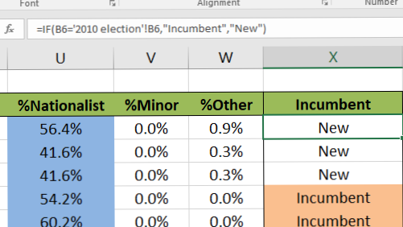
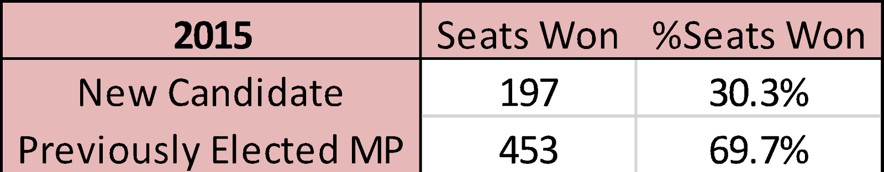
The Incumbent Effect
Almost 70% of seats won in 2015 were won by the previously elected MP.
Previously elected candidates strengthened their lead from 47.1% to 50.5% on average.
Previously elected candidates outperformed their respective parties.

Slide 11
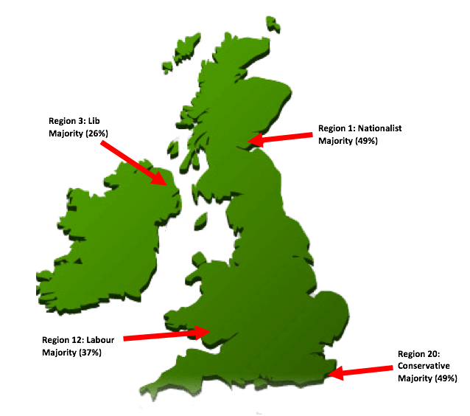
Further Analysis
A significant amount of votes for the Conservative Party came from region 20 in England.
A significant amount of votes for the Scottish Nationalist party came from Region 1 in Scotland.

Slide 12
Analysis of the 2015 Election
Electorate: 46,428,805
Turnout: 30,697,854, as a percentage 66.12%
The average turnout across all constituencies as a percentage was 66.05%
These are the results of the general election by seats
CON: 333
LAB: 235
LIB: 16
UKIP: 1
GRN: 1
NAT: 63

Slide 13
Election Results 2015 graphed
National vote does not reflect seats won because Parliament is elected constituency by constituency.
UKIP, the Liberals, and the Greens failed to win seats because their vote was not dense enough in Westminster constituencies.

Slide 14
Analysis of the 2010 Election
Electorate: 45,601,060
Turnout: 29,687,737, as a percentage 65.10%
The average turnout across all constituencies as a percentage was 65.02%
These are the results of the general election results by seats
CON: 307
LAB: 261
LIB: 65
UKIP: 0
GRN: 1
NAT: 14

Slide 15
Election Results 2010 graphed
The Liberal Democrats won more votes than they ever had done but failed to topple sufficient numbers of Labour and Conservative MPs in their constituencies, and so did not receive proportionate representation.

Slide 17
Simulating the 2017 Election
Conservative up 3%, Labour down 10%, Liberals down 5%, UKIP up 12% on 2015
For 2b) the minimum increase in vote required for an ex-MP to take their seat back would be 0.09%

Slide 18
Alternative 2017 Simulation
Conservatives down 5% and UKIP up 5%, Labour down 7% and UKIP up 7%, if UKIP is 2nd.
For 2b) the minimum increase in vote required for an ex-MP to take their seat back would be 0.01%

Slide 19
Combining The Simulations
For 2b) the minimum increase in vote required for an ex-MP to take their seat back would be 0.09%.

Slide 20
Further Analysis
Questions we decided to ask:
If there were an Empty Chair party comprised of non-voters, how would they fare?
Jeremy Corbyn said that Labour under his leadership would enthuse non-voters to vote for him and this would propel him to Number 10. What % of non-voters is required for a Labour majority?
What is the minimum integer percentage that Labour must win directly from the Conservatives to win a majority in the Commons?
What are the seat predictions for the Conservatives if the worst and best opinion polls were accurate?

Slide 21
Empty Chair
Empties would get 34% of the vote.
Results:
EMPTY: 346 (+346)
CON: 210 (-123)
LAB: 41 (-194)
LIB: 2 (-14)
UKIP: 0 (-1)
GRN: 1 (0)
Conservatives would have 69% of all remaining seats.

Slide 22
Non-Voters switch to Labour
33% of non-voters needed. Or 5.2 million voters. 325 seats won. Majority of 1.
Turnout increased to 76%. Labour vote share at 41%. Conservatives down to 32%.

Slide 23
Conservatives switch to Labour
Working majority of only 30. Never before seen swing since 1997. 339 seats won for Labour. 219 for the Tories.
Only 2.7 million voters would need to change their minds, which represents 24% of Conservative voters changing their minds.
It is more efficient for Labour to convince Conservative voters than to convince non-voters.

Slide 24
Worst opinion poll 20th April
Tories only increase their majority from 12 to 50.
Labour would lose 13 seats.
Results:
CON: 350
LAB: 221
LIB: 12
UKIP: 2
GRN: 2
NAT: 62

Slide 25
Best opinion poll 13th April
Best ever result for the Conservatives since 1931.
Majority of 198.
Labour’s worst result since 1931.
Results:
CON: 424
LAB: 151
LIB: 30
UKIP: 0
GRN: 1
NAT: 43

Slide 26
Conclusion
The voting system used to elect the House of Commons is not proportional. However first past the post grants local constituents the right to hire and fire their local MP.
Smaller parties which find it difficult to gain representation by winning a spread of votes should opt for a ‘decapitation strategy’ and target constituencies where they are strong in order to maximise their representation.

Slide 27
Group Effectiveness
Group chat on Facebook for fast communication.
We helped each other improve our reports.
Group meetings generally had high attendance
Alex and Cameron analysed the general election results using Microsoft Excel.
Michael analysed the general election results using MATLAB.
Manny made the presentation.
Jamie compiled the reports and made the Wiki.

